Slide 1
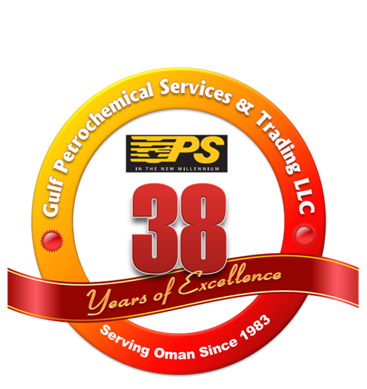

A brief on:
Gulf
Petrochemical
Services & Trading LLC
(Established in 1983)
www.gpsoman.com
Phone +968 24392900 / Fax +968 24489446 / E-mail: gpsoman@omantel.net.om

Slide 2
About GPS

Slide 3
Company Profile & Business Segments
Gulf Petrochemical Services & Trading L.L.C (GPS) is a leading Omani owned Contracting and Trading Company with active participation in Oman's Hydrocarbon, Petrochemical and Energy Sector industries since 1983.
Core business operations of GPS are as follows:
Engineering, Procurement and Construction (EPC) Contracting (Civil, Mechanical, Electrical, Instrumentation & Structural) for Hydrocarbon and Process Industries;
Engineering, Procurement and Construction of Water and Wastewater Facilities and Networks;
Construction Services in Civil, Mechanical, Electrical & Instrumentation categories;
Construction of Pipelines and Storage Facilities;
Specialist activities such as Pre-Commissioning, Commissioning, Design, Installation and Monitoring of Cathodic Protection Systems, long –term Operations and Maintenance services for Oil and Gas Sector facilities and pipelines;
Technical Representation and Trading of specialist products for the Oil, Gas and Energy Sector industries;
The Company is currently rated as one of the leading EPC Contractors in the Sultanate of Oman with business activities spread across GCC member Countries.

Slide 4
Vision
Our Vision is to be recognized as being one of the best EPC Contracting and Trading Companies in Oman. To provide our employees with living facilities in accordance with the requirements and standards of the Government of Oman and PDO. Making employees aware of hazards to their health and providing them with all necessary personal protection equipment. Ensuring employees are not subjected to stress problems in their work environment.
Mission
Our mission is to continuously improve all of our business activities in order to achieve a level of excellence that permits us to provide the highest satisfaction to all our Clients and our Employees.
Industrial Relation
Our aim is to achieve a commendable industrial relationship with all parties involved or participated in our business. This includes the Government of the Sultanate of Oman, our clientele, principal companies, local and overseas suppliers, employees and sub-contractors. Fulfilling obligations towards all our business associates and a management objective of good industrial relations.

Slide 5
Operations Areas & Business Share

Slide 6
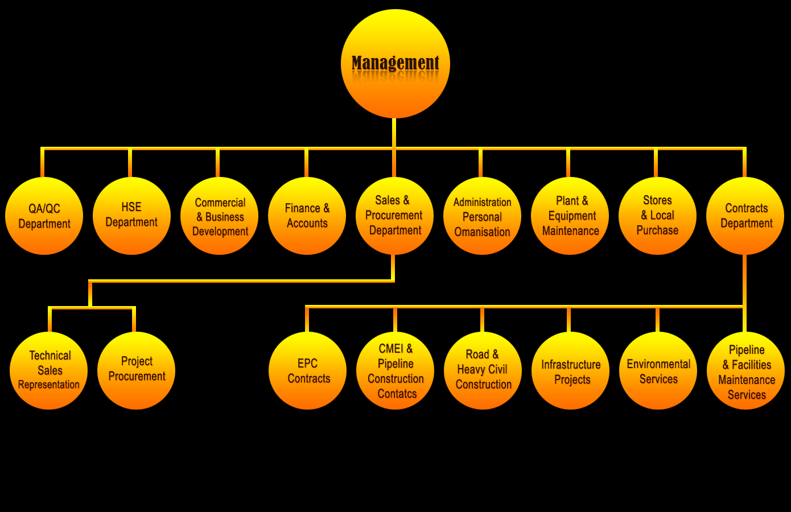
Operational Structure

Slide 7
Operation - Management

Slide 8
HIGHLIGHTS
One of the largest pool of Resources amongst the contractors in Oman;
Contracts executed for over 300 projects in Oman;
Experience in EPC Contracts for Green/Brown-Field Projects;
Executed large construction contracts for On-Plot and Off-Plot Projects;
Leading Pipeline Contractor in Oman;
Executed over 6000 Km of Pipelines from 6” to 64” in the last 15 Years;
Constructed large Storage Terminals;
Oil & Gas Facilities such as Gathering Systems, Production Stations; Booster / Compressor Stations, Tank Farm for Refinery; Terminal Facilities including Pumping Stations;
Working experience with leading Engineering Service Providers;
Vast experience in Project Procurement Services;
In-house Civil, Mechanical, Electrical & Instrumentation Construction Capabilities;
Large fabrication facilities;
Availability of experienced manpower for immediate mobilization;
Best industry statistics on Health, Safety & Environment Management and Performance;
Best Quality Management System;
Strong financial capabilities to support large value contracts;
Included in the list of 6 major EPC Contractors in Oman.

Slide 9
Resources

Slide 10
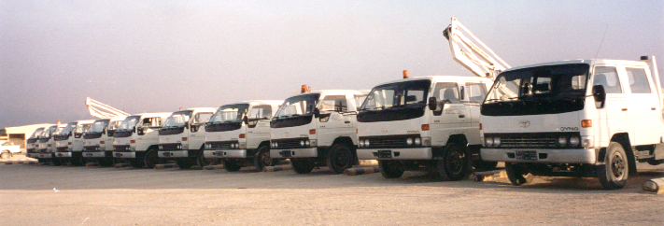

Resource Availability:
GPS is considered as one of the leading contractors having plant and equipment resources fully owned and over 5000 manpower in its direct employment.
We are currently spending an average of R.O. 2.0 (Two) Million annually (last 5 years) to modernize our plant and equipment in order to meet the ever increasing challenges and demands of the industry.
Plant & Equipment: A fleet of more than 1750 pieces of plant and equipment.
Offices: More than 6000 Sq. M. of Air-conditioned & modern Office facilities in the Capital Area. In addition to this office facility, we have a large office facility available within the Central Facilities of GPS in Barka and Jiffnain (Under construction). All project locations are also equipped with most modern office facilities.
Accommodation: Accommodation facilities available at various Interior project locations. This is in addition to various accommodation facilities available within the Capital Area including the 1200 Man Camp in our Central Facilities at Barka.
Fabrication Shops: Central Fabrication shop and related infrastructure is located within the Central Facilities in Barka. Additionally a number of fabrication and workshop facilities are available at Interior locations as part of our project site facilities. Total Area of this facilities is approx. 120,000 Sq. M.
Workshops: More than 8000 Sq. M. of workshop facilities with necessary tools and instruments are located within the Central Facilities.
Storage Over 8000 Sq. M. of covered storage and 25000 Sq. M. of open storage area is available.
Resources and industrial facilities owned and used by the company meet with the highest industry standards in terms of safety, utility and quality.

Slide 11
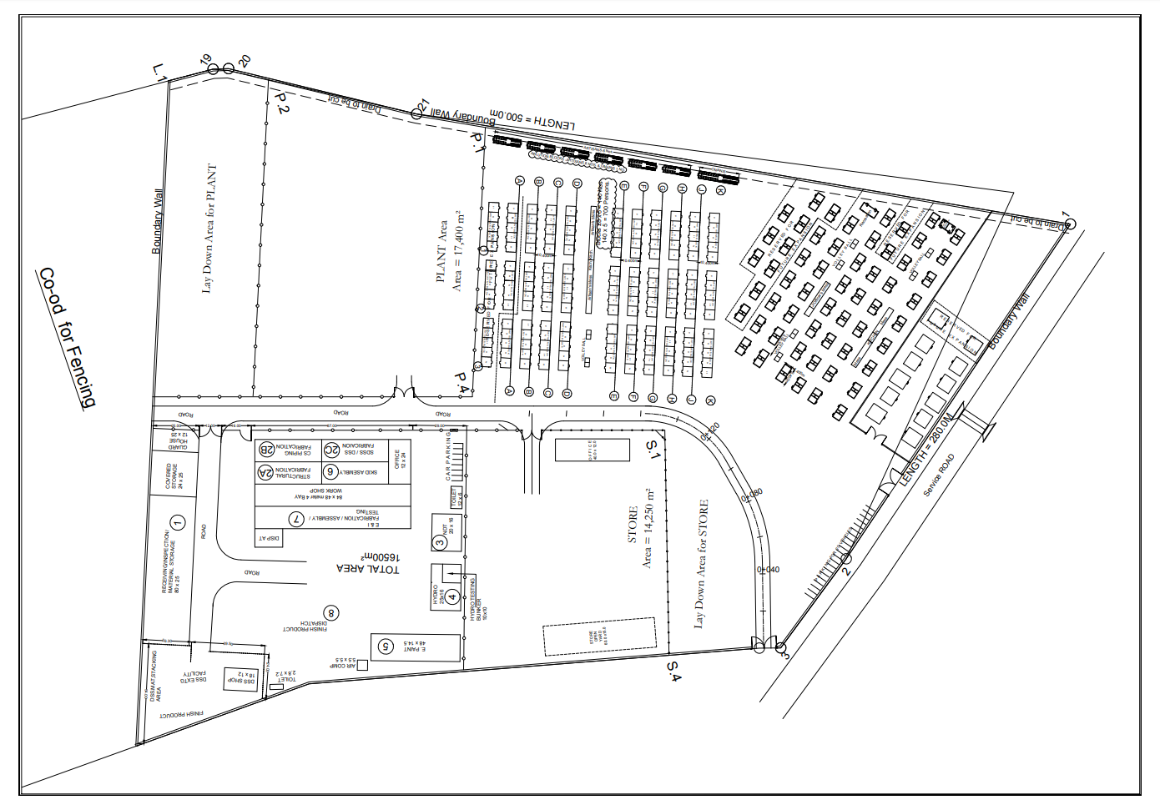
Central Industrial Facilities and Camp at Capital Area (Barka)

Slide 12
Fabrication Facilities:
GPS’s in-house fabrication facility is at Barka which is ideally located between Sohar & Muscat and near to the Express Highway. Our Facility is well equipped to cater all types of fabrication like process skids, process piping, Vessels, heavy structural, Painting & Testing. Covered Facilities include Office Room with Conference facility, Safety Training Centre, heavy fabrication bays, vessel fabrication unit, High pressure testing bunks, Mechanised blasting units & painting bay, Pre casting area and areas exclusively for exotic materials welding.
Total area of the facility is in excess of 50,000 Sq M with Fully Covered fabrication areas of around 6,000 Sq M. with EOT crane & material handling system. The Facility also includes sufficient Material storage areas (covered & open), Finished Product area, Loading/ unloading area.
Our operations are certified to ISO 9001:2015 Quality Management System, ISO/TS 29001, ISO 14001:2015 & ISO 45001:2015. This facility is approved by our Clients like Petroleum Development Oman, ORPIC, BP in Oman, Oman Gas Company, OOCEP. GPS Fabrication facility also certified and authorized by ASME to use U, S stamps and NBIC certified to use R stamp for the repair and alteration of boilers, pressure vessels and pressure retaining items.
All projects undertaken at GPS Fabshop facility are overseen by our experienced shop team. Our QA/QC team ensures that quality and turnover documentation exceeds what our clients expect. Our Project Managers ensure that customer schedules are met for on-time delivery, while providing continual progress communication so that project status is always known.

Slide 13
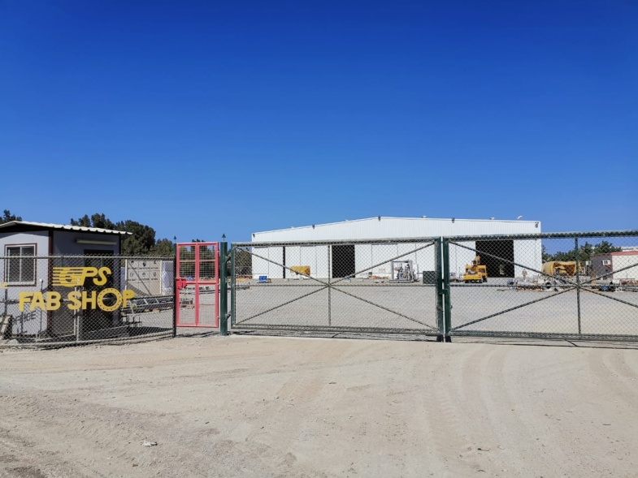
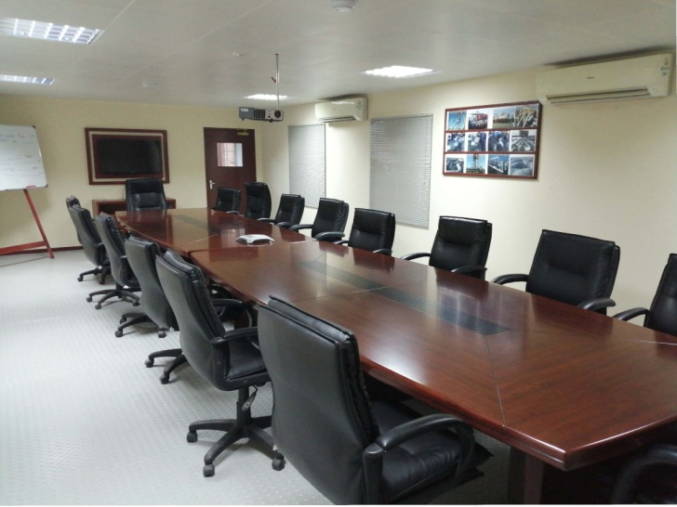
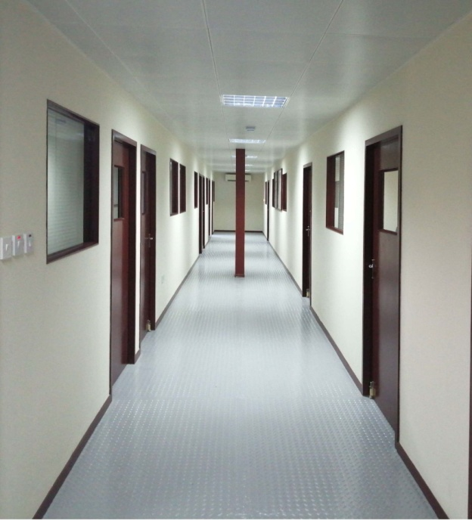
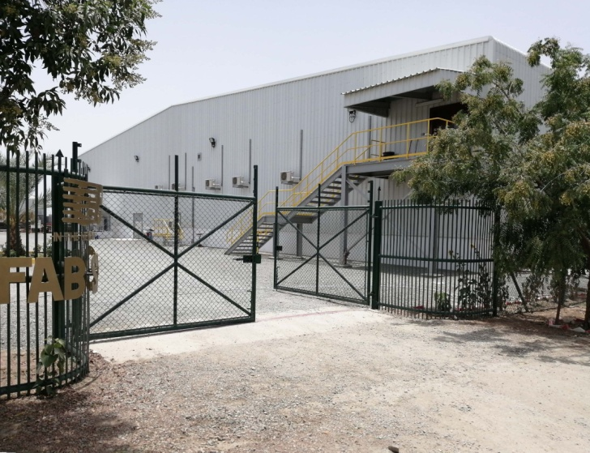
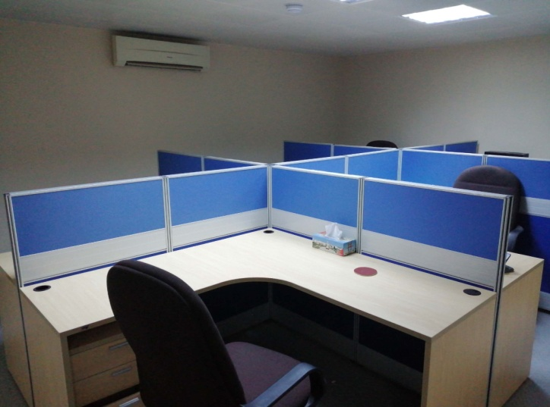
Fabrication Facilities:

Slide 14
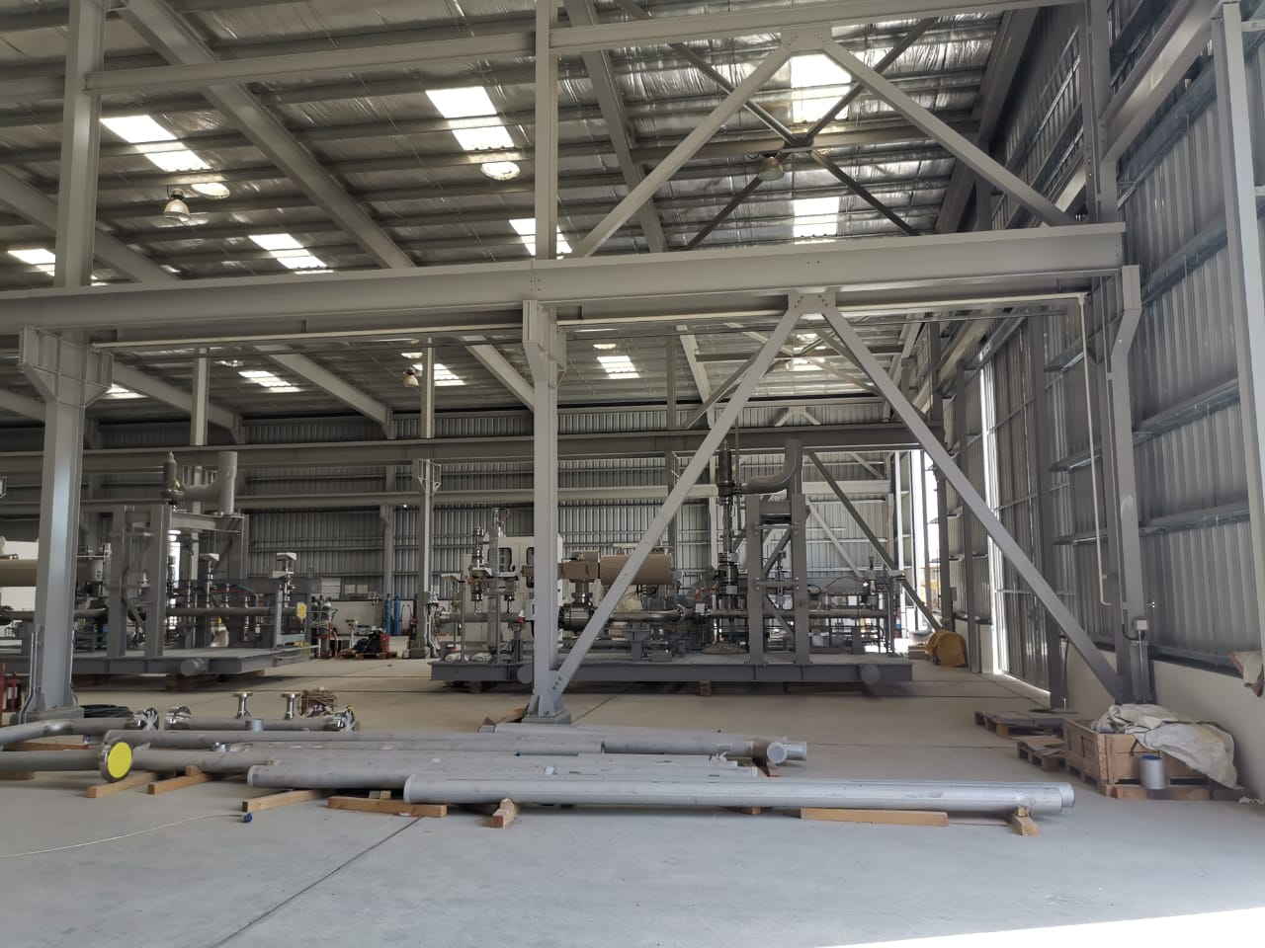
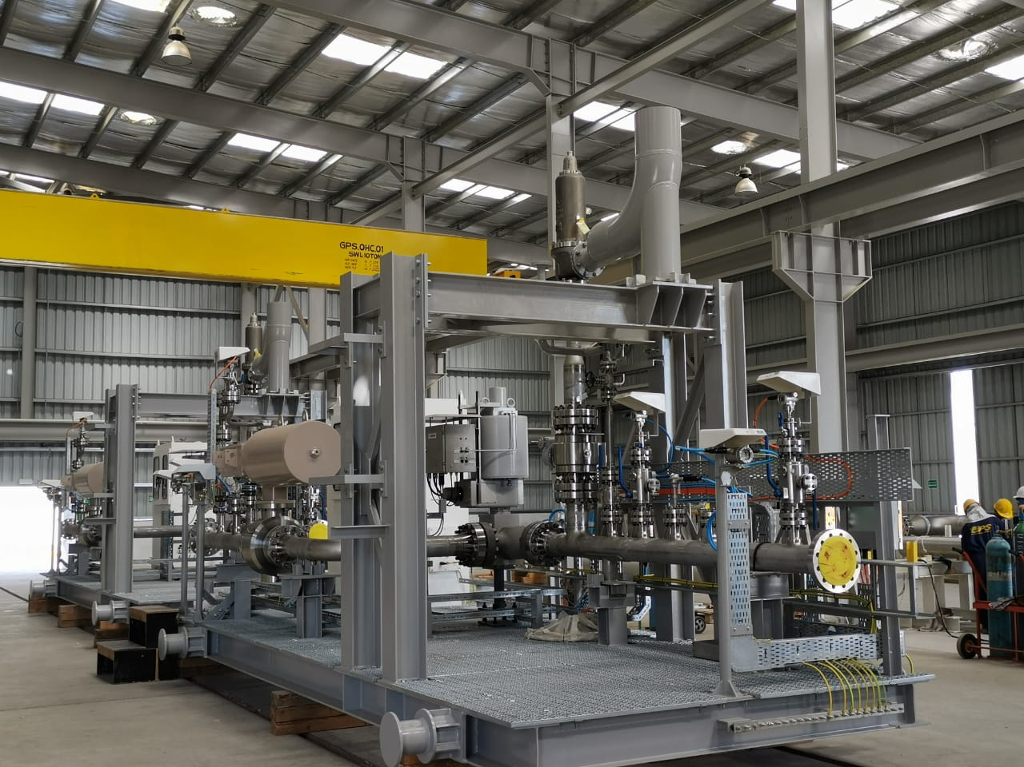
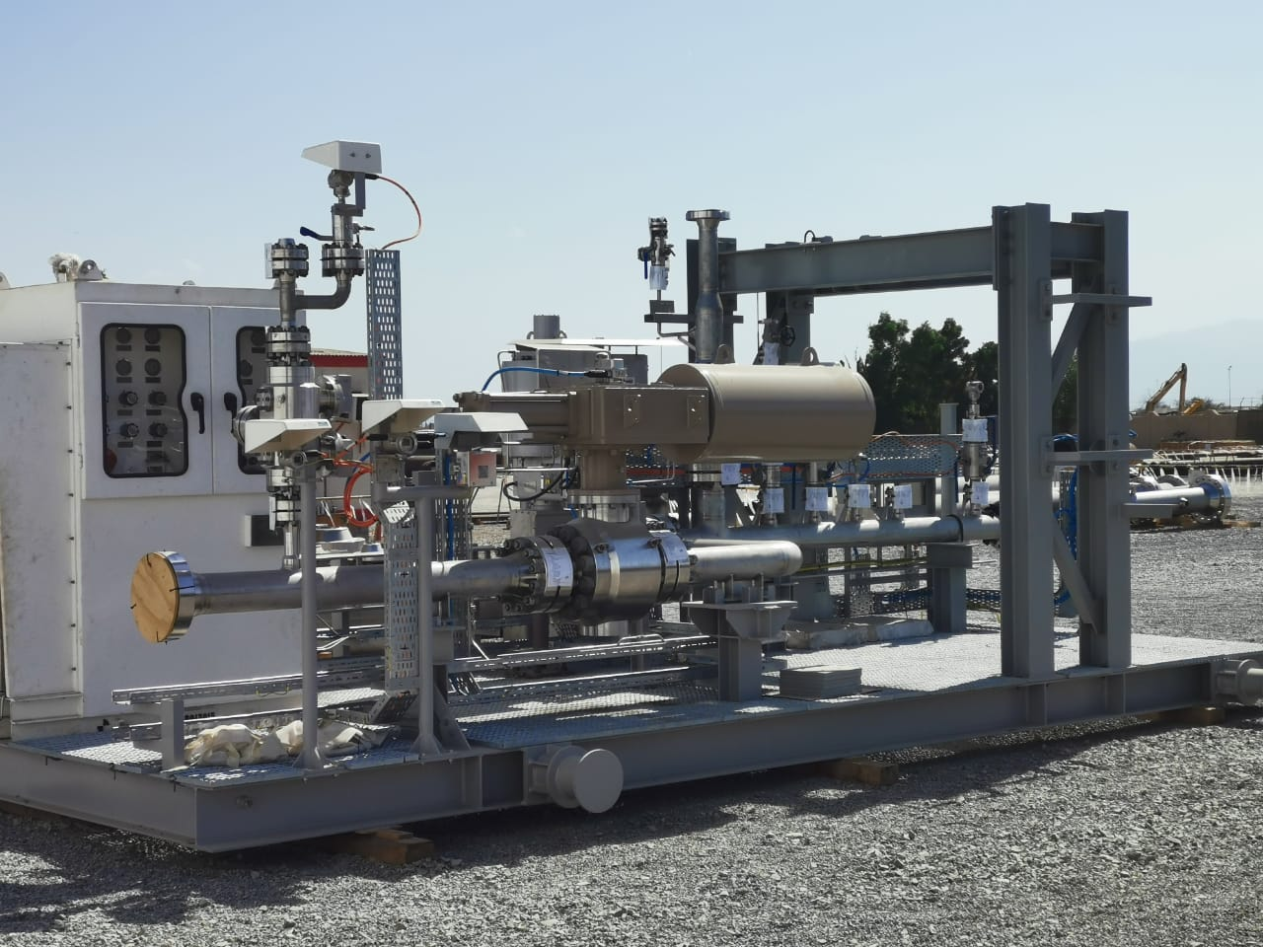
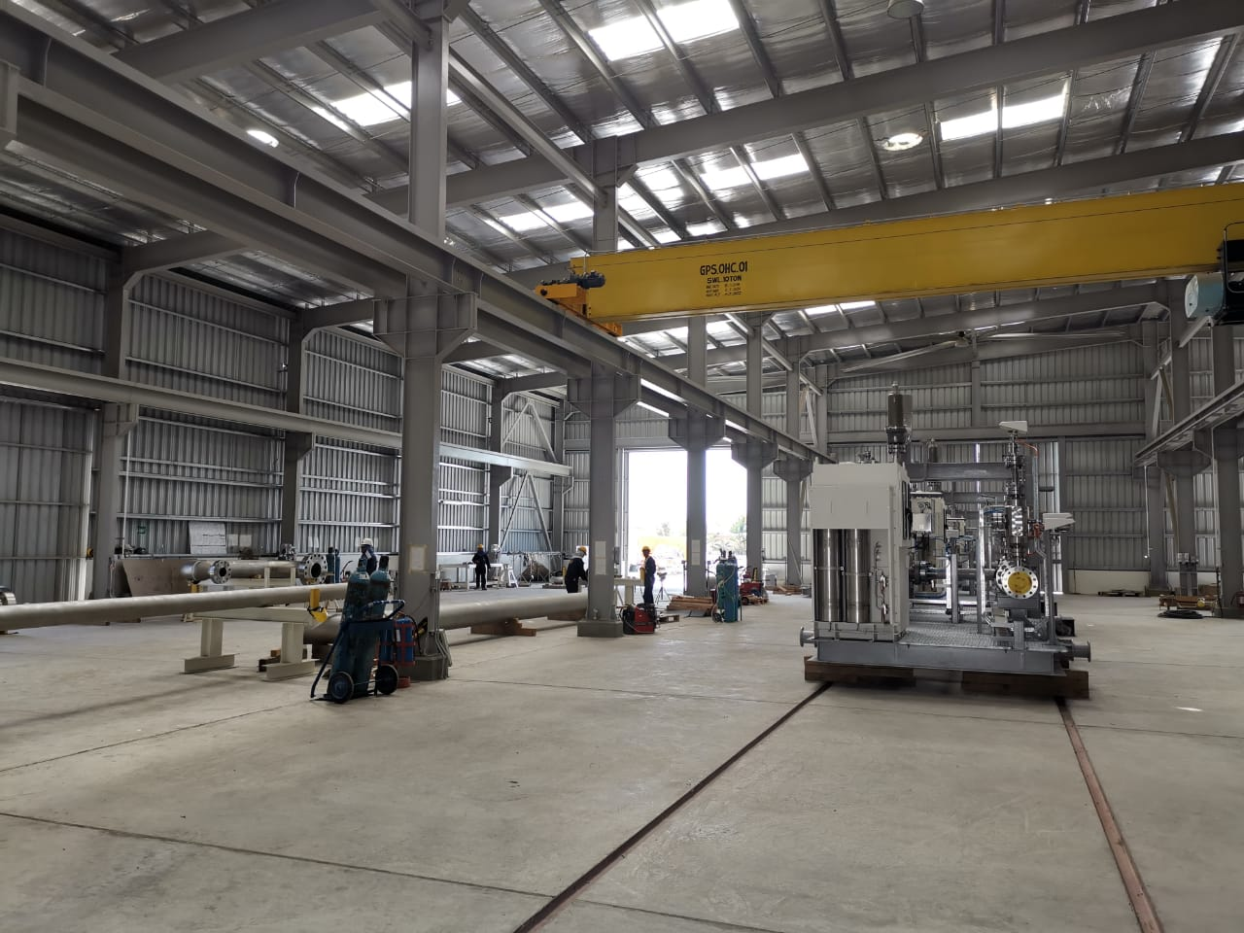
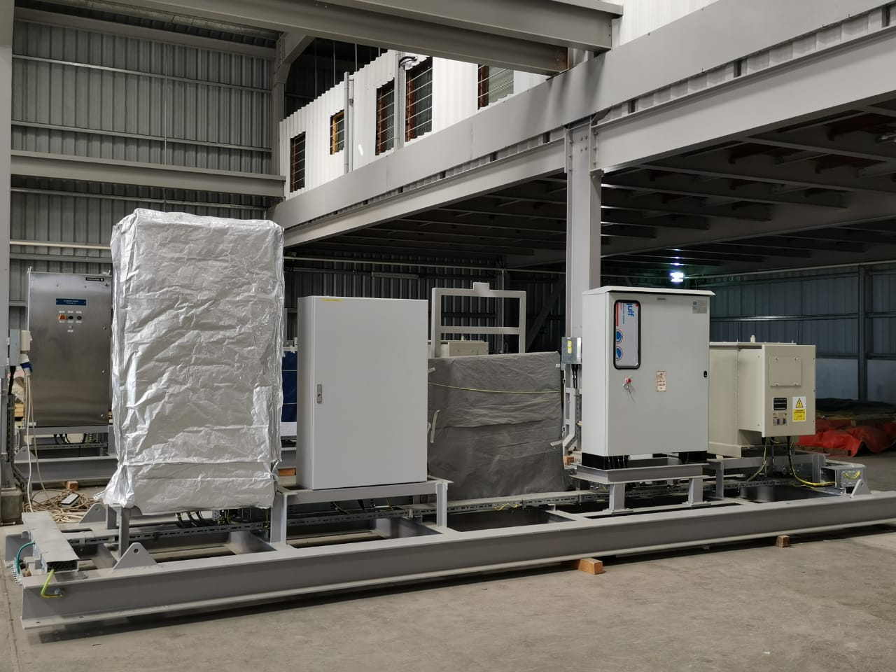
Fabrication Facilities:

Slide 15
Certifications / Accreditations

Slide 16
Certifications / accreditations and / or memberships:
Quality Management System: ISO TS29001 : 2010
ISO 9001 : 2015
Environment Management System: ISO 14001 : 2015
Occupation Health & Safety Management System: ISO 45001 : 2018
International Pipeline & Offshore Contractors’ Association: IPLOCA
Pipeline Pigging & Services Association: PPSA
Oman Society for Petroleum Services: OPAL
Oman Society for Contractors OSC
Joint Supplier Registration System JSRS
Milestone Achievements:
First Omani company in its category to get to ISO 9000 accreditation (in 1995)
First, and currently the only, Omani contractor holding regular membership to IPLOCA
First and only Omani Company holding full membership to PPSA
Founder member of OPAL.

Slide 17
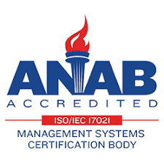





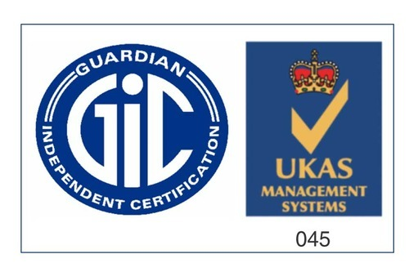

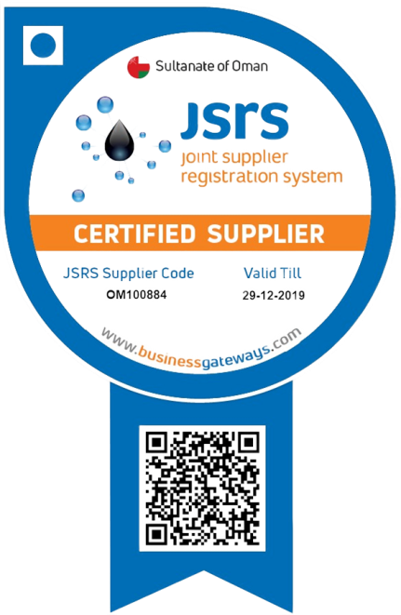
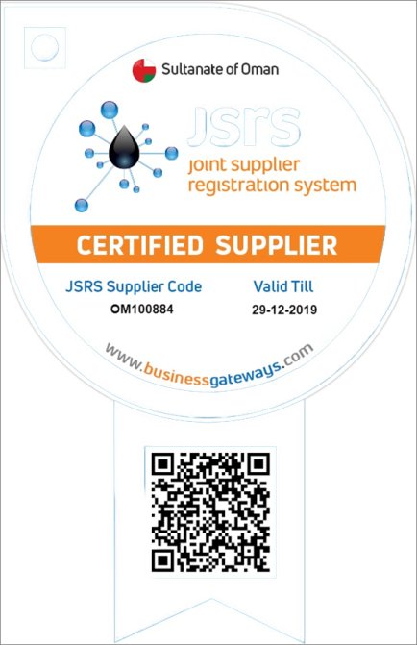
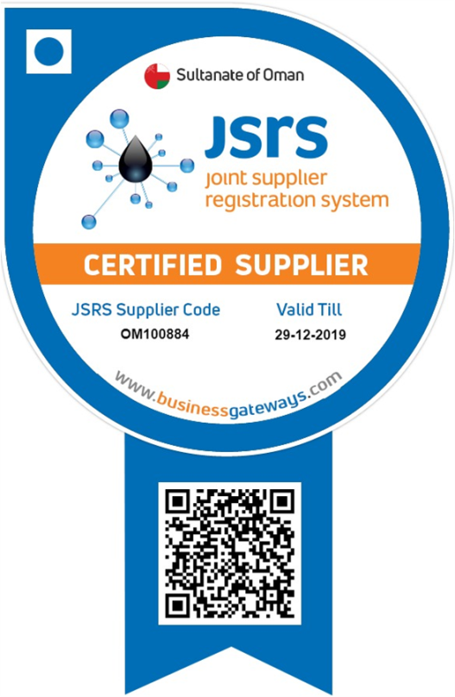
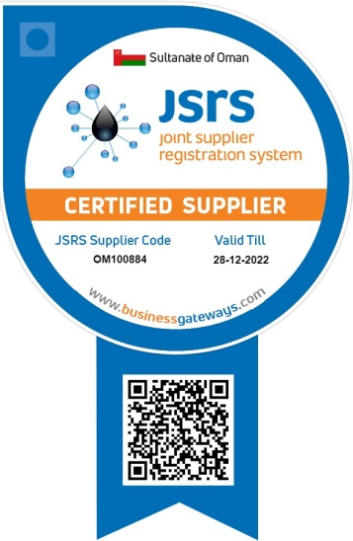

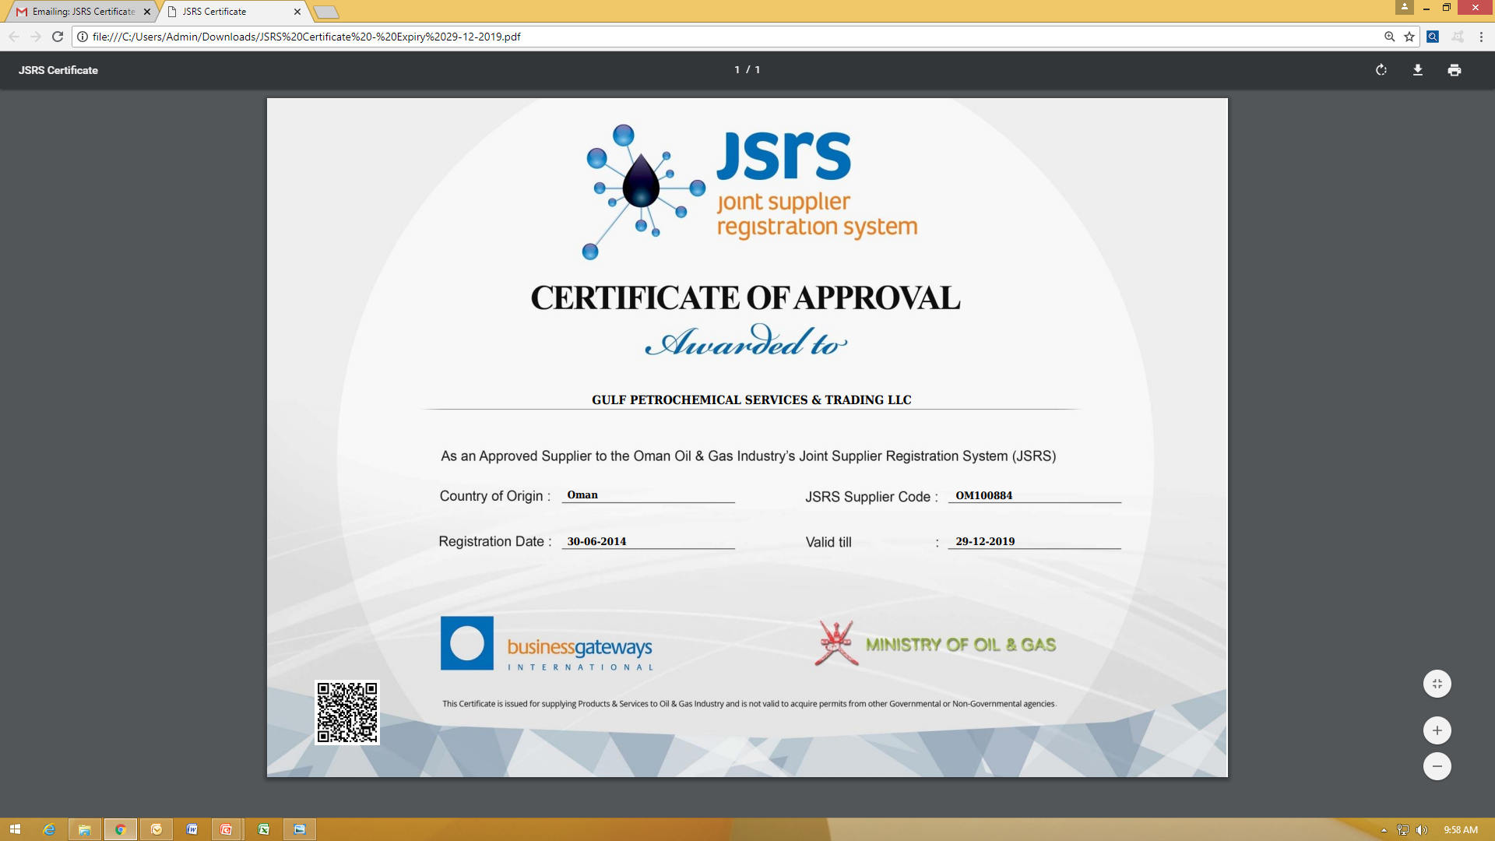


ISO 9001 : 2015
Certificate Number: 32677
ISO / TS 29001 : 2010
Certificate No. 50090
ISO 45001:2018 Certificate No. 690125
ASME U & S STAMPS
Certificate No. 54403
AUTHORIZED MANUFACTURER
Certificate No. 10442
ISO 14001:2015 Certificate No. 690615

Slide 18
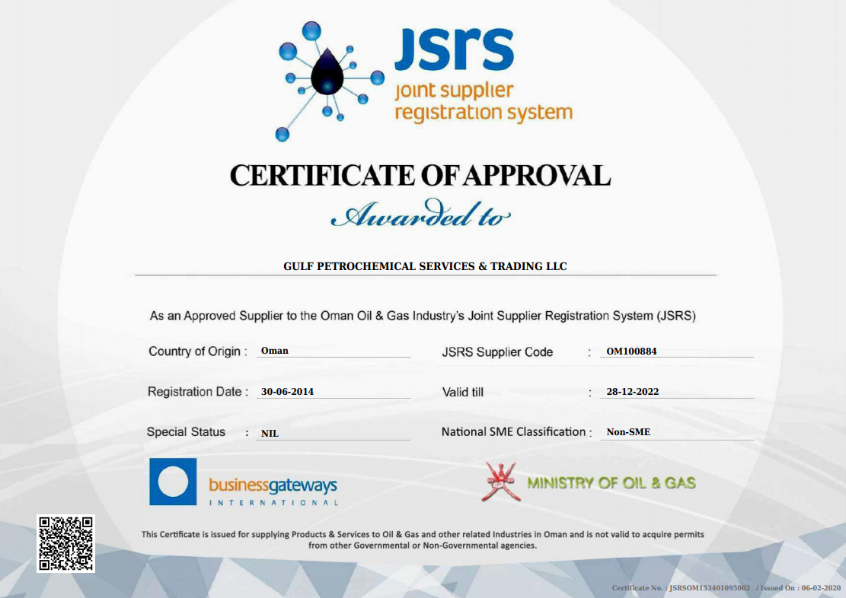

Slide 19
Clientele

Slide 20








Experience / Clients: Oil & Gas:
Petroleum Development Oman LLC (PDO)
Oman Gas Company (OGC)
Oman Refineries and Petrochemical Industries Company (ORPIC)
ORPIC Logistics Company (OLC)
Oman Oil Company for Exploration & Production (OOCEP),
Occidental of Oman Inc.
Occidental Mukhaizna LLC)
BP Khazzan
Daleel Petroleum (Oman) LLC
Mina Petroleum Inc.

Slide 21






Experience - Clients: Non-Oil & Gas:
Ministry of Regional Municipalities & Environment
Muscat Municipality
Haya Water
Public Authority for Electricity & Water (PAEW)
Salalah Sanitary Drainage Services Company (SSDC)
Dubai Electricity & Water Authority (DEWA)

Slide 22
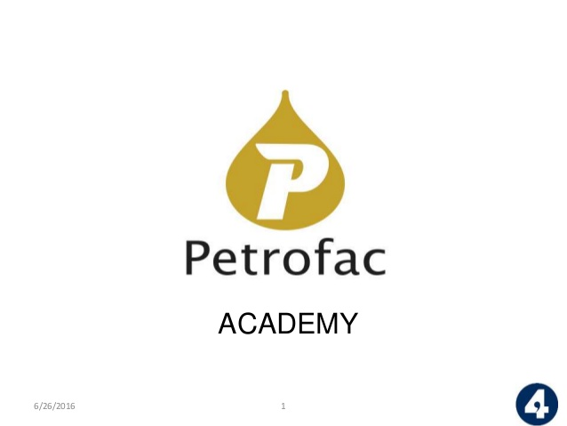







Experience: Joint Ventures / Major Sub-Contracts:
Petrofac International – Sub-Contractor for Pipeline Package for Salalah LPG
Bechtel Corporation – Specialist Sub-Contractor for Civil and Mechanical Construction for Sohar Aluminium Smelter
Punj Lloyd – Joint Venture (JV) Partner for OGC Pipeline & PRT Project
L&T Limited – Joint Venture (JV) Partner for Water Transmission Pipelines, Booster Stations and Tanks / Reservoirs for Salalah Region for the Minister of State & Governor of Dhofar
CB&I – Specialist Sub-Contractor for EPC of Mina Al Fahal Tank Farm for PDO
Office of the Minister Of State & Governor of Dhofar

Slide 23
Core Business Activities

Slide 24
Engineering, Procurement and Construction (EPC)
Greenfield and Brownfield On-Plot and Off-Plot facilities;
Cross-Country Pipeline and Flow-line Construction;
Fuel Storage & Handling Systems including related facilities;
Large Compressor and Gathering Stations;
Pre-Commissioning and Commissioning Activities;
Heavy Civil Construction related to Oil and Gas projects;
Water Transmission Systems & Pumping Stations;
Wastewater Conveyor Systems and Treatment Plants;

Slide 25
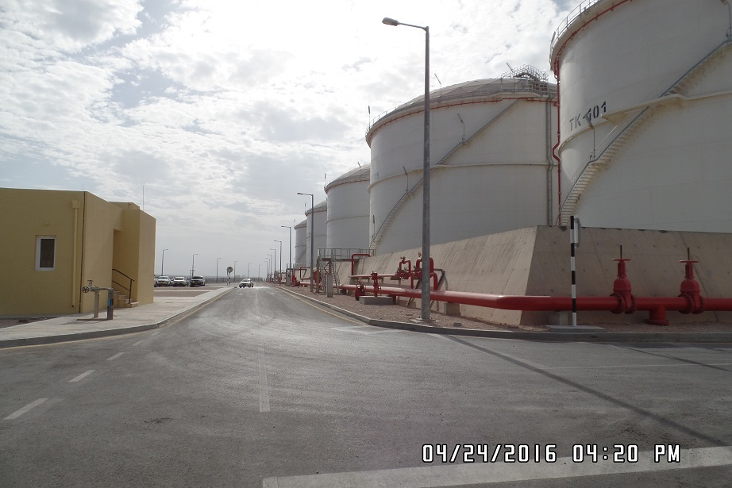
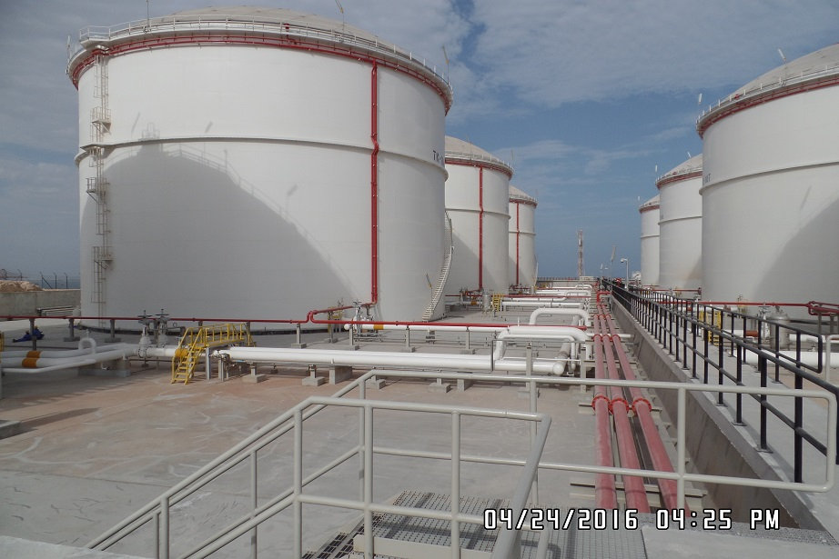
Engineering, Procurement and Construction (EPC)
GPS hold extensive capabilities as an EPC (Engineering, Procurement & Construction) Contractor for any large value contracts involving Civil, Mechanical, Electrical, Pipeline & Instrumentation Construction.
GPS is highly experienced in Greenfield and Brownfield EPC projects for CME & I Facilities and pipeline / flow line construction, including all types of fabrication works, design, fabrication and erection of petroleum storage tanks, related civil works / earth works and related building works.
Products Storage Facilities at Salalah
For Mina Petroleum Corporation

Slide 26
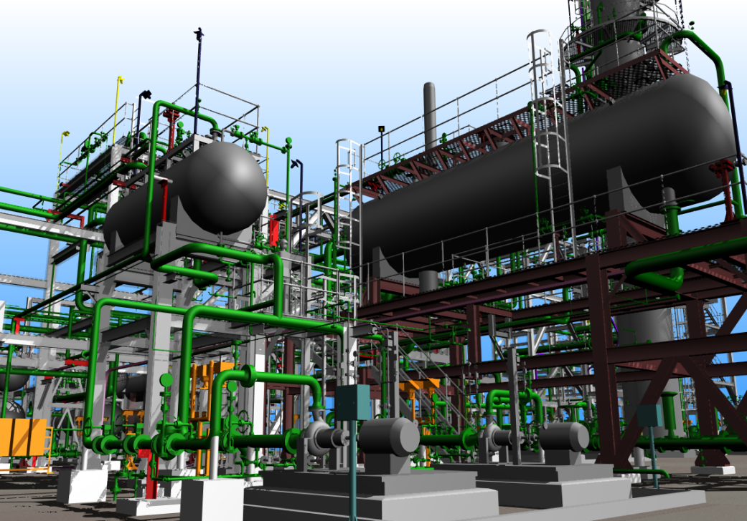
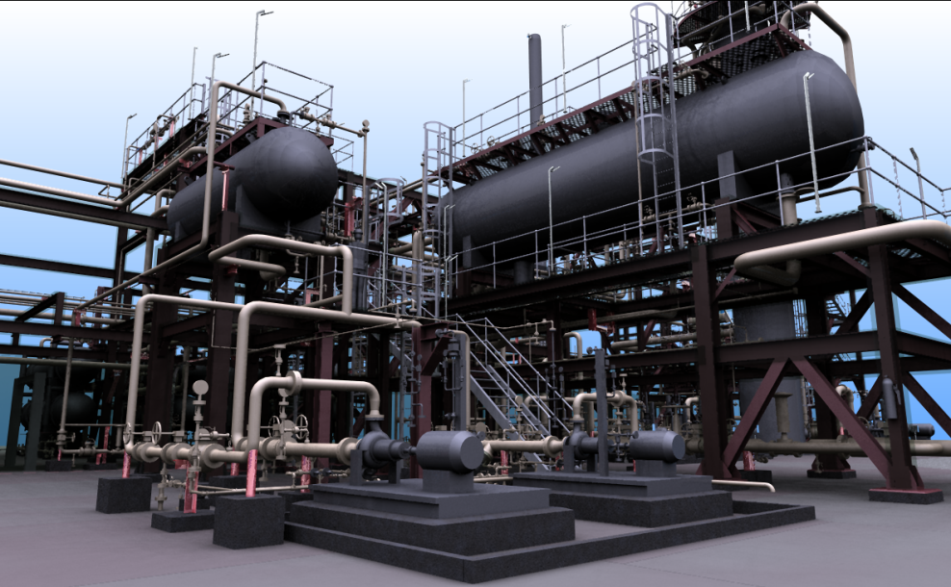
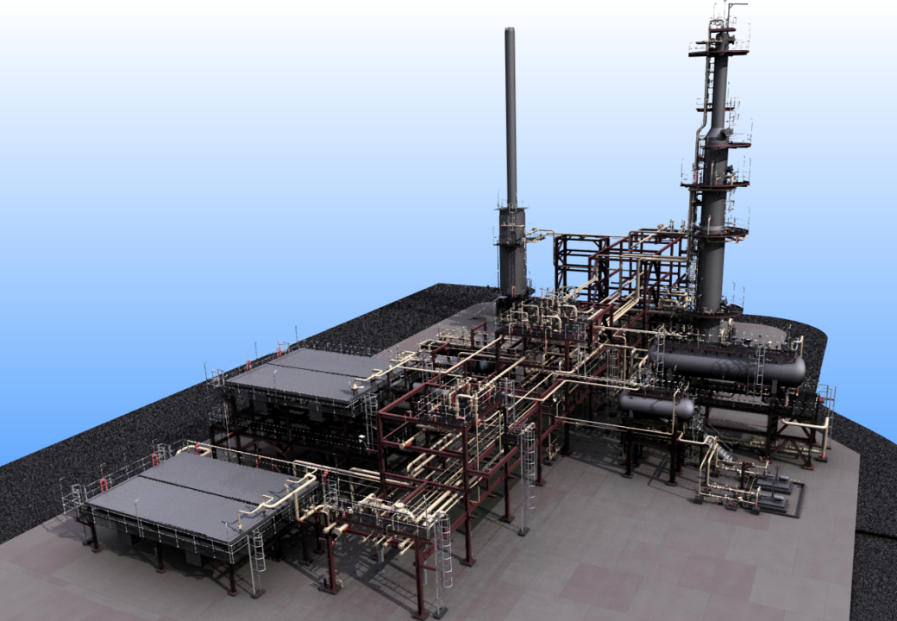
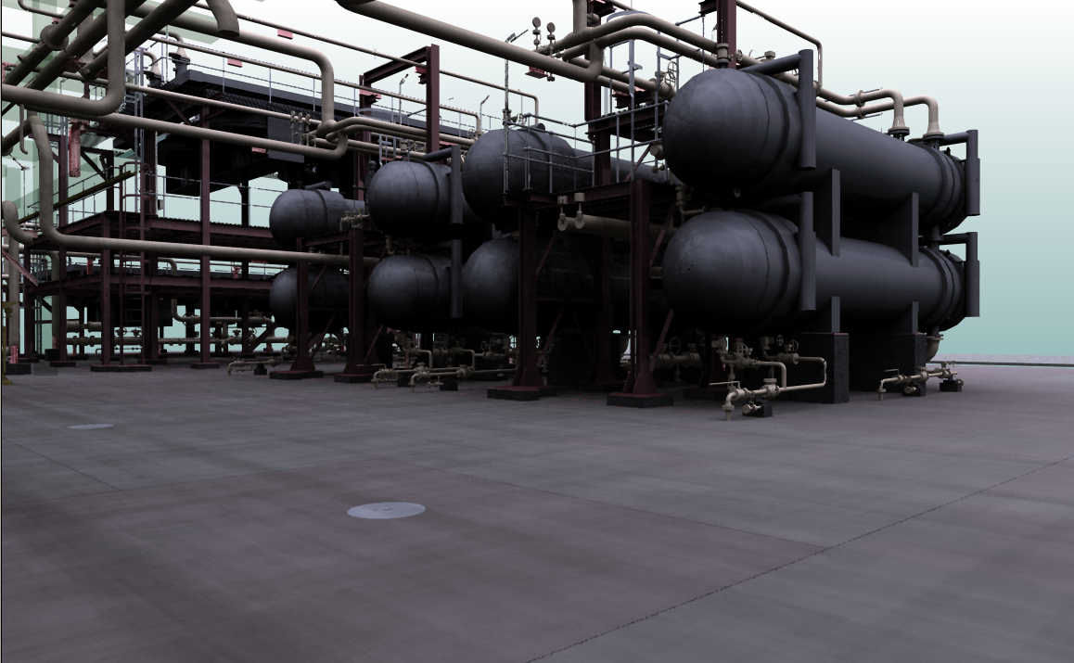
3D Model of Crude Stabilization Plant
for Occidental Group in Oman

Slide 27
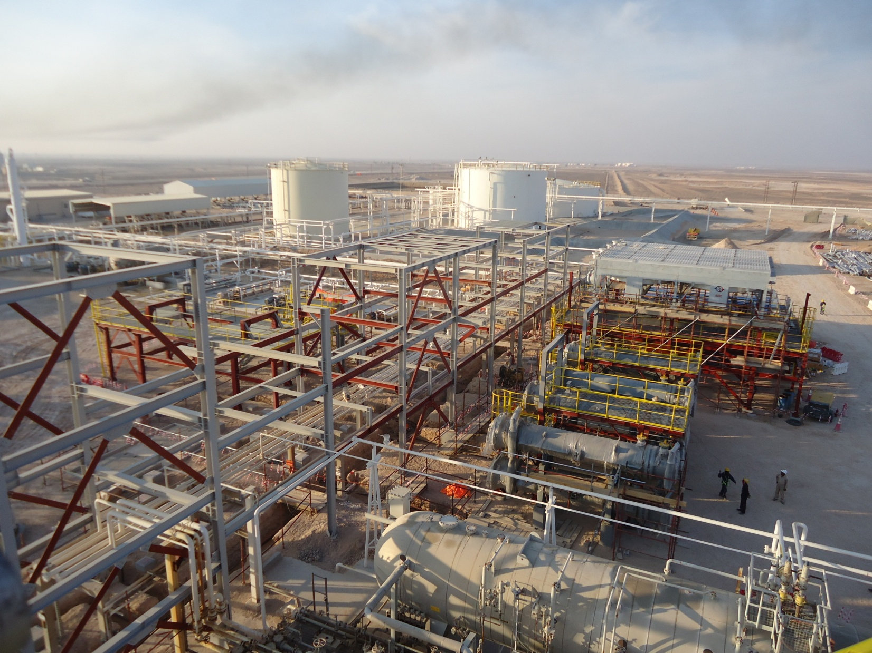
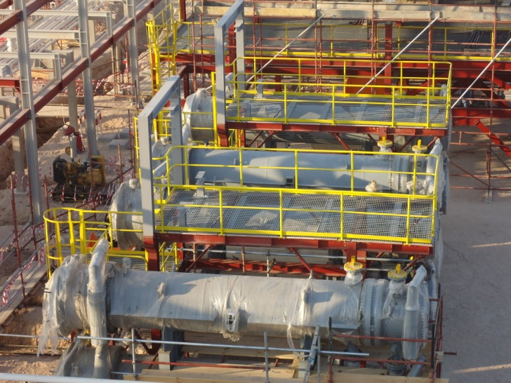
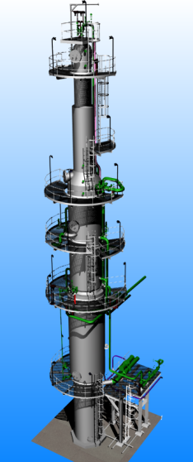
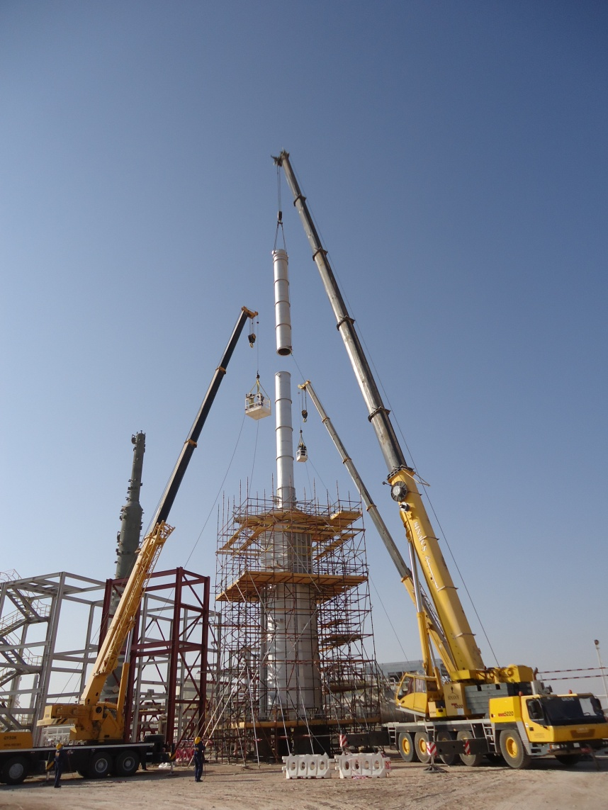
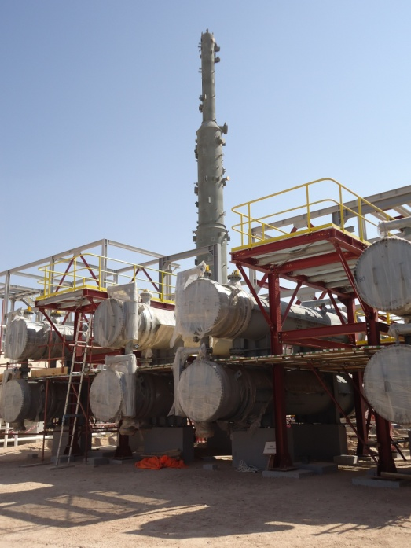
EPC of Crude Stabilization Plant
for Occidental Group in Oman

Slide 28
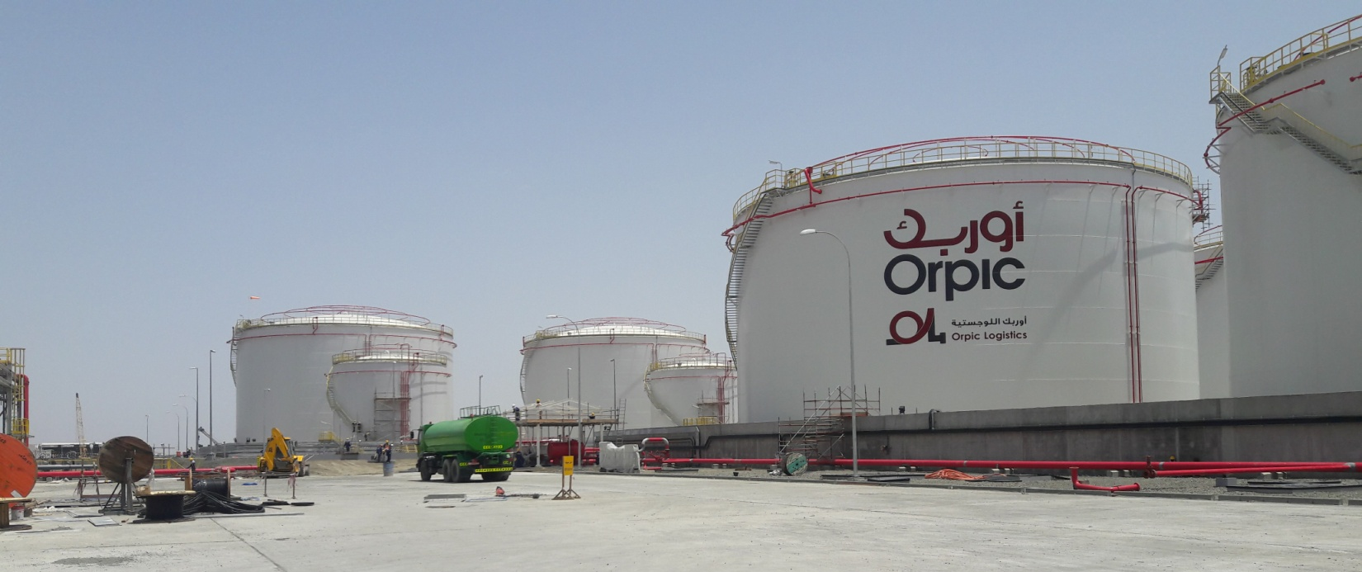
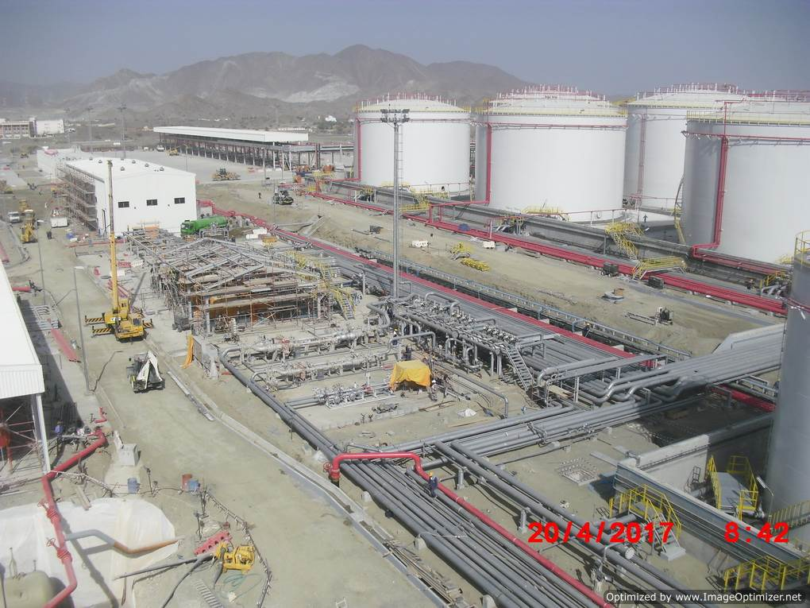
Muscat – Sohar Products Pipeline Project (MSPP)
Al Jiffnain Storage Facilities (14 Tanks)
&
Fuel Handling System at Muscat

Slide 29
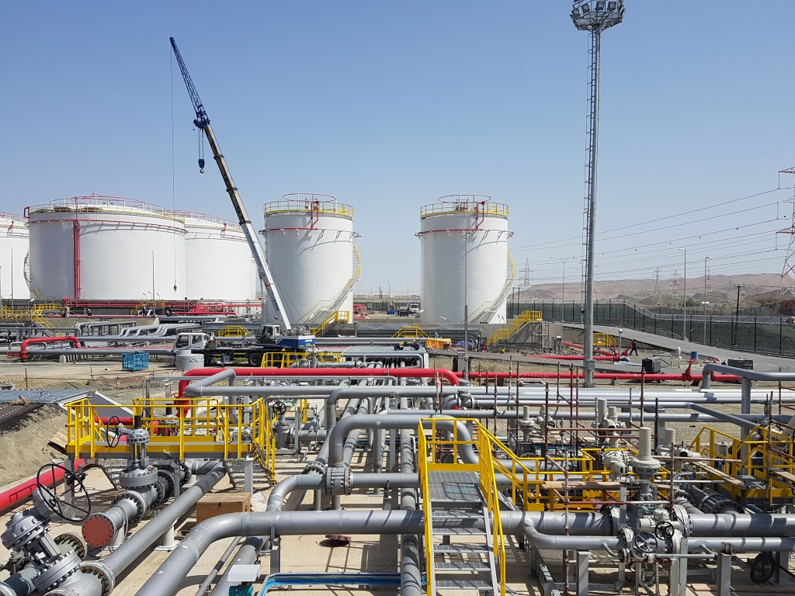
EPC of Storage and Pumping Facilities at Jiffnanin (Muscat – Sohar Products (Multi) Pipeline, Storage & Fuel Handling Facilities. (Inset) EPC of Haban Field Development.

Slide 30
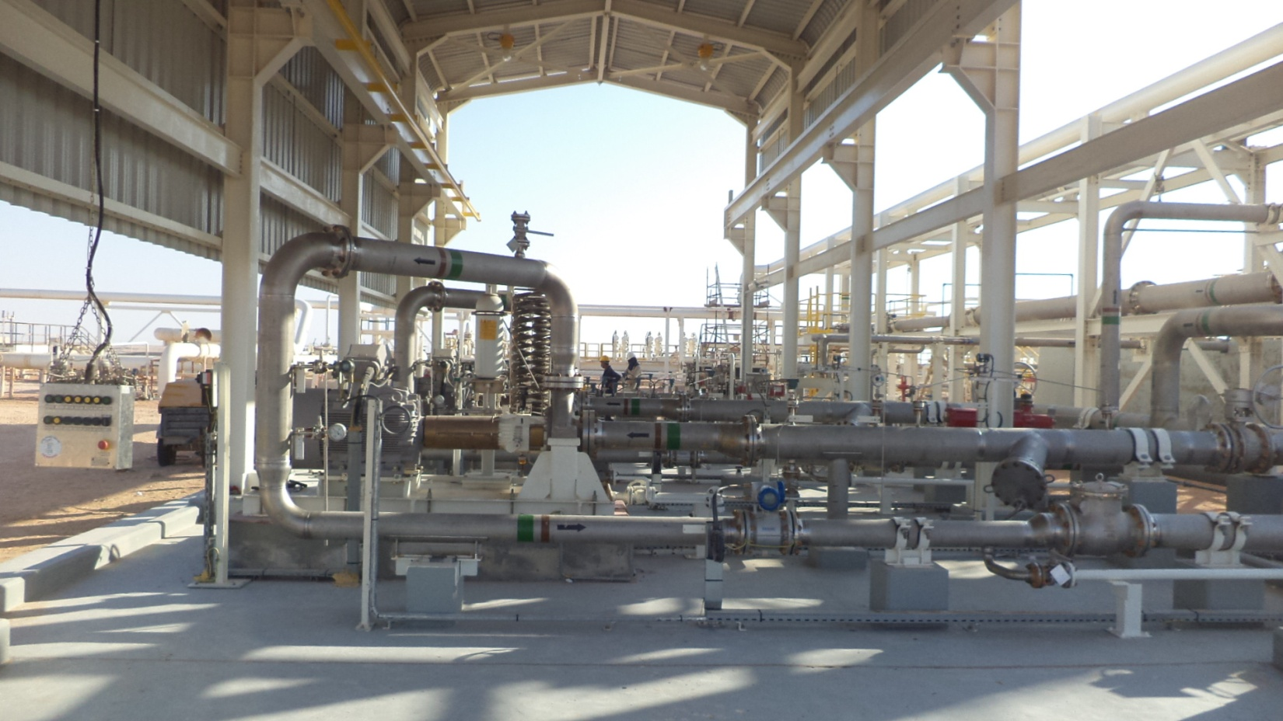
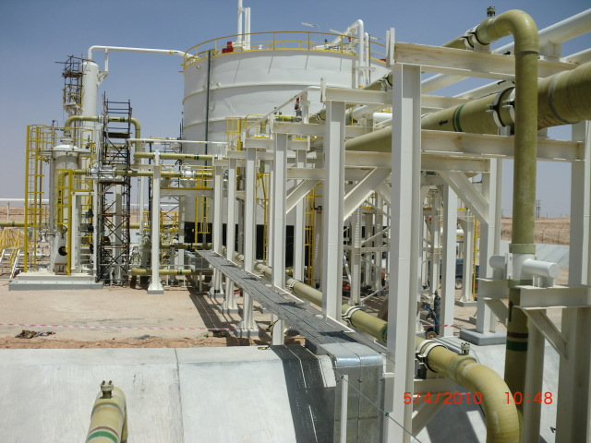
EPC of NFA Integrity Project – Saih Rawl

Slide 31
Construction Services
Civil, Mechanical, Electrical & Instrumentation projects;
Fabrication and Skid Manufacturing;
Structural Steel Fabrication and Erection Works;
Preparation and Completion of Drill /Well Sites;
Heavy Civil Construction Activities;
Earth Works and Site Preparation Works;
Sewage Treatment Plant (STP) and related activities;
Water supply pipelines;
Water treatment (RO Plant) facilities;

Slide 32
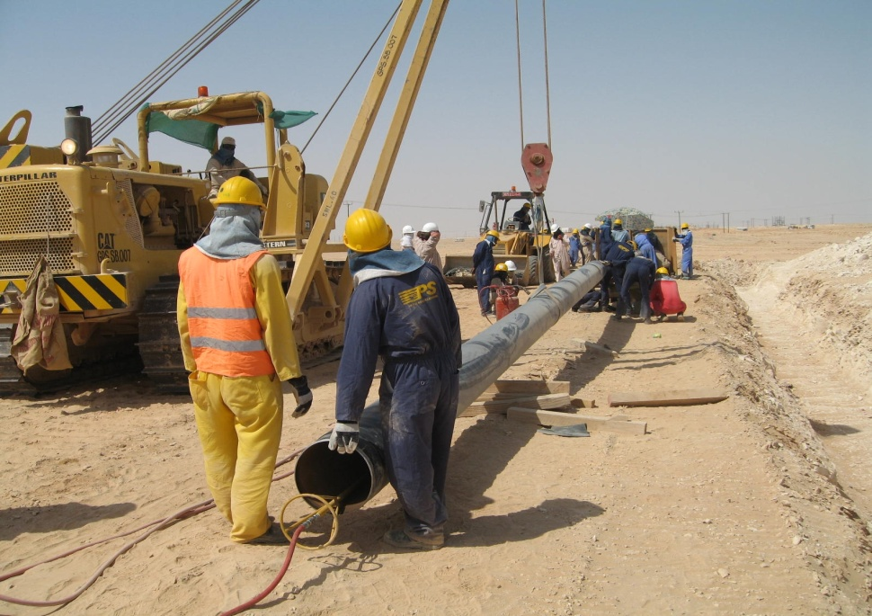
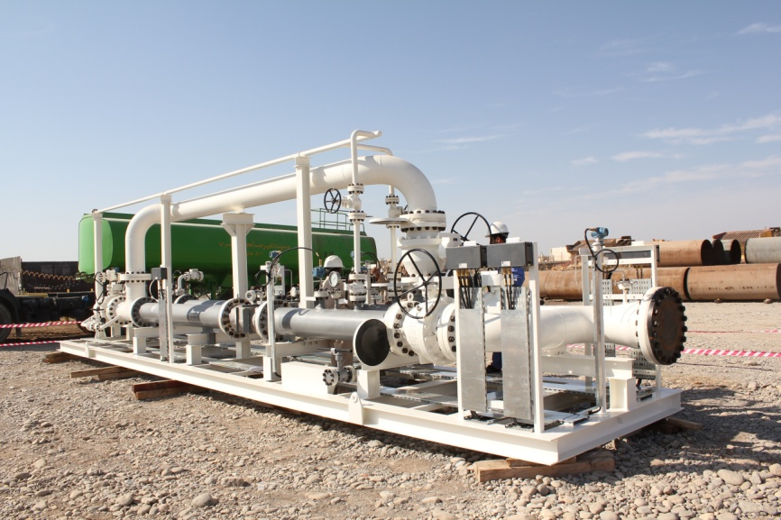
GPS Experience in Pipeline Construction (EPC) Projects
GPS have executed several Pipeline Engineering, Procurement and Construction Contracts for all major operators in Oman.
As an Omani Pipeline Contractor, GPS owns the largest fleet of pipeline construction resources in the Region which is certified by International Pipeline & Offshore Contractors Association (IPLOCA).
Having completed over 6000 Km. of Pipelines of various sizes ranging from 6” to 64”, using various types of metals including DSS, Super Duplex and other CRAs, GPS hold considerable experience in executing large pipeline projects in Oman and UAE.

Slide 33
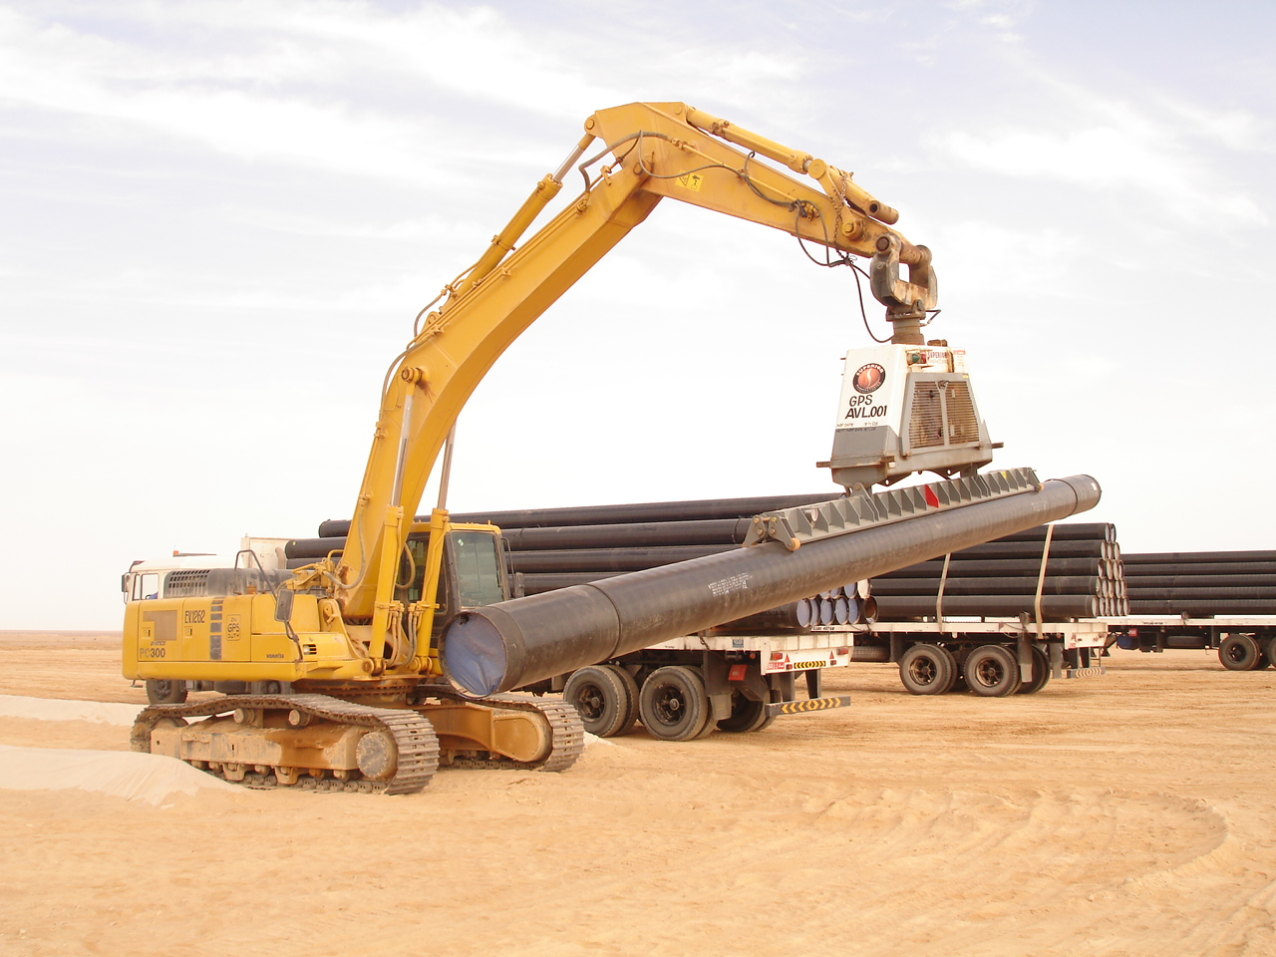
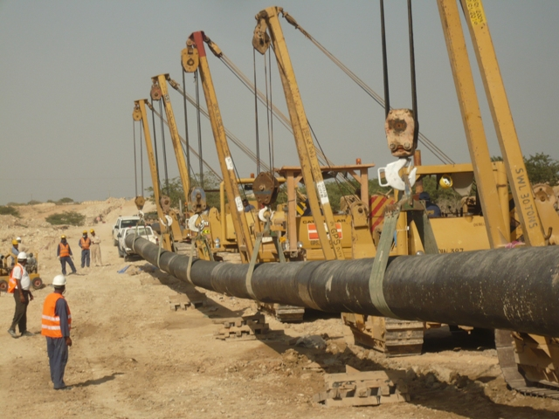
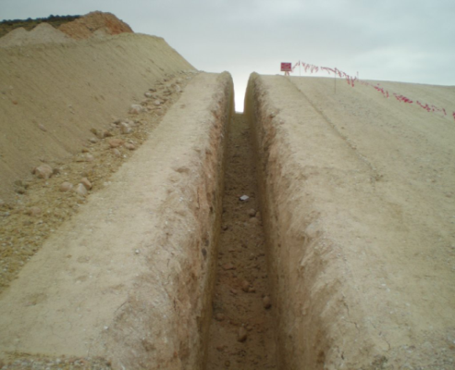
Water Transmission System and Reservoirs
Salalah

Slide 34
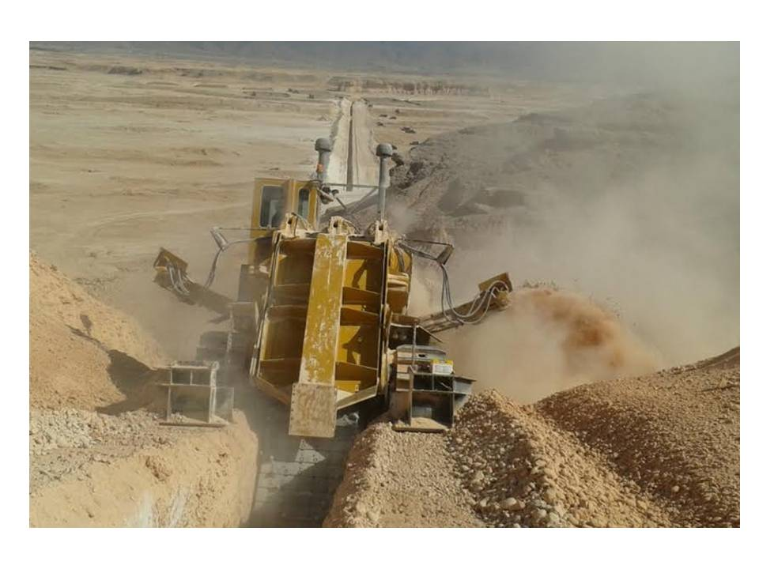
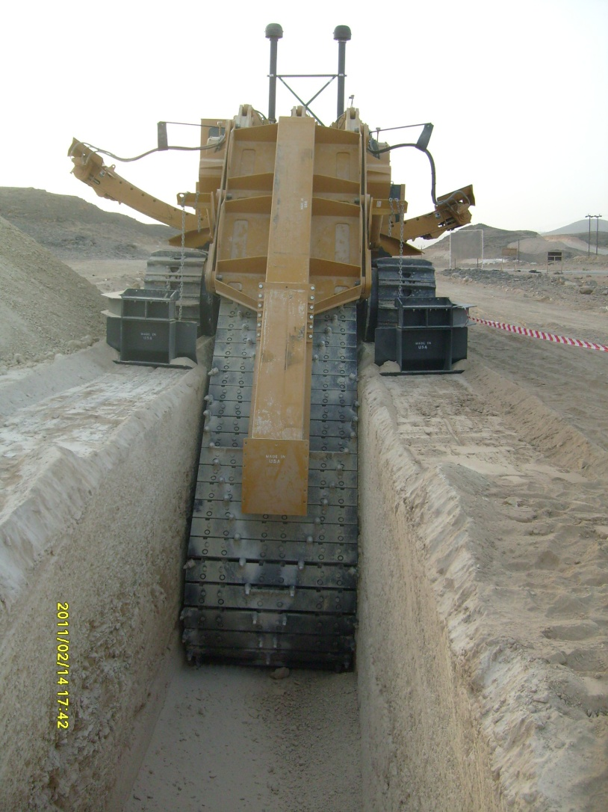
Salalah Water Transmission System Contract

Slide 35
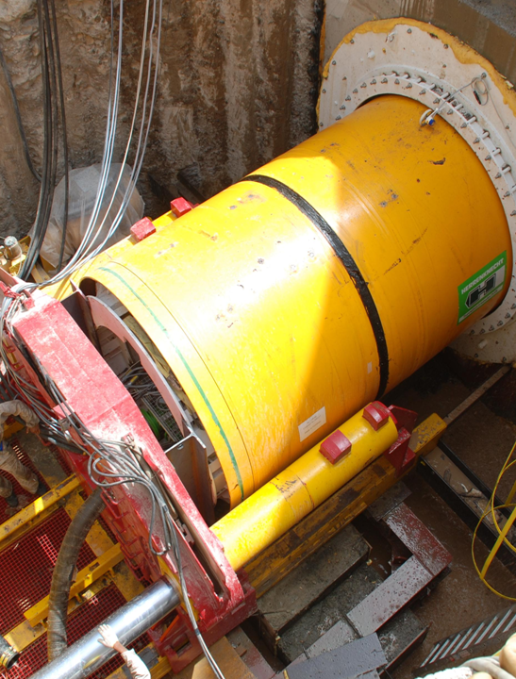
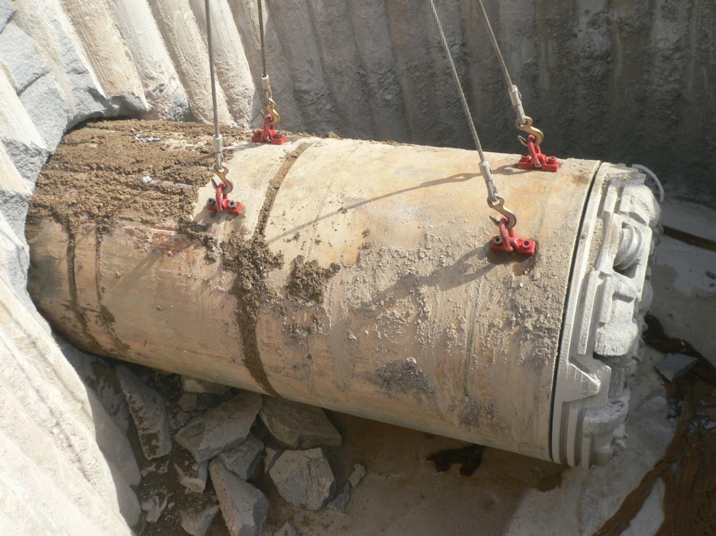
Infrastructure Projects
This division is providing support to our clients and contracting partners in the field of infrastructure construction activities.
This division is capable of undertaking large infrastructure development projects using our own resources.
Site preparation for infrastructure development projects;
Construction of large accommodation and recreational facilities;
Provision of utilities such as, Electricity, Water supply and Sewerage systems;
Main sewer collection and conveyance systems;
Service connections for residences and collection centers;
Sewage Treatment Plant (STP) and Water Treatment Plant (RO & Desalination) construction;
Trenchless pipeline construction services including micro-tunneling services for large diameter underground conveyance systems;
Sub-sea pipelines and rework to marine facilities;
Micro-tunnelling Works for Main Collector Sewer for A’Seeb Sewage Collection and Conveyance System

Slide 36
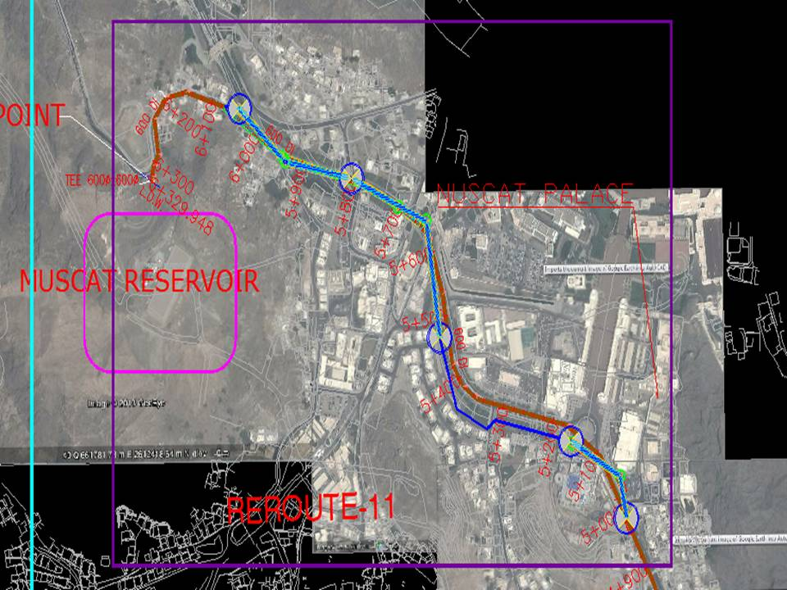
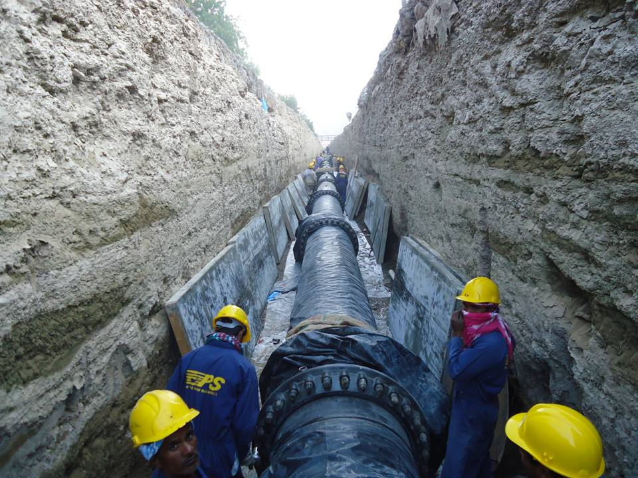

Water Transmission Pipelines from Al Ghoubra to Muscat Reservoir and Pumping Station

Slide 37






Water Transmission Pipelines from Al Ghoubra to Muscat Reservoir and Pumping Station

Slide 38



Water Transmission Line in Muscat

Slide 39



Al Ghoubra – Muscat Main Water Transmission System
Main Pumping Station Construction, Oman

Slide 40

Construction of Dolphin Tanks and Underground Services
for Atlantis Hotel in Dubai

Slide 41


Marmul – Andhur Road Project at Marmul, Oman for PDO

Slide 42


EPC of Underground Systems & Dolphin Tank Piping
for Atlantis Hotel in Dubai

Slide 43




Construction of Sea Outfall for
Mina Al Fahal Refinery, Muscat - Oman

Slide 44

GPS Experience in Facilities (On-Plot) Construction
GPS have executed several contracts for Engineering, Procurement and Construction of process facilities, gathering systems, pumping systems, launcher and receiver facilities, fire fighting systems, control buildings and sub-station facilities, etc. in the Oil & Gas Sector.
Storage and Pumping Facilities at Jiffnanin
Muscat – Sohar Products (Multi) Pipeline, Storage & Fuel Handling Facilities

Slide 45





Slide 46



Slide 47



Slide 48

A project for
Petroleum Development of Oman in Suwaihat

Slide 49


A project for Petroleum Development of Oman in Lekhwair

Slide 50


Mechanical Works at LIWA Plastics
(SRIP & Jetty Area) - Sohar

Slide 51



Mechanical Works at LIWA Plastics
(SRIP & Jetty Area) - Sohar

Slide 52




Mechanical Works at LIWA Plastics
(SRIP & Jetty Area) - Sohar

Slide 53
Operations, Maintenance & Specialist Service Contracts
Pipelines and Facilities Maintenance;
Pipeline External /Internal Corrosion Monitoring;
Pipeline Integrity Management /Maintenance;
Cathodic Protection System Design, Construction, Monitor, etc.;
Hydro-static Testing and Commissioning Activities;
Pre-commissioning and Commissioning Activities;
Specialist Environmental Services;
Right-of-Way Maintenance;

Slide 54









Technical Trading / Representation Activities:
GPS hold exclusive representation of various manufacturers of products for the Oil and Gas Industry.
With the help of a highly qualified and experienced team of technical staff of over 30 personnel, this department is actively involved in the technical trading and procurement services for the Oil, Gas, Water and Energy Industries in the Region.
Most of our principals are associated with us for a long time and GPS was instrumental in developing some of them in the regional markets.
We have expeditors / special representatives in the US, Europe and Far-Eastern Countries to follow-up, monitor and to provide necessary updates on quality and delivery schedules.
STOPAQ EUROPE

Slide 55





Technical Trading / Representation Activities:

Slide 56
Technical Trading / Representation Activities:
GPS represents the Mechanical, Electrical & Instrumentation Products from world-class principals in Oman.
PRINCIPAL | PRODUCTS REPRESENTED
Atmos International (formerly REL Instrumentation), U.K. | Pipe line Leak detection software package (gas & liquid) Pipe line Theft detection, Simulation software package.
BORRI S.p.A, Italy | 3 & 1 Phase Rectifier Battery Charger. Industrial Inverter, UPS System, AC/DC Distribution panel.
Corrosion Tech. Services ME LLC - UAE | Corrosion Protection, Solar Panels & other supply items related to CP.
Crystal Industrial Syndicate Pvt. Limited | Filtration system, fabrication etc.
NOV Fiber Glass System, U.S. / Oman | GRE Pipes and Fittings (Elbow, Tees, Reducers, Couplings, Nipples etc). Well down hole tubing, casing and LLRTP Pipes.
GD Engineering, UK | Bandlock High pressure quick opening closure. Rotalock small size quick opening closure. Hi-T Pigalert intrusive type, Ultra Pigalert non intrusive type.
Inoxtech, Italy | Higher alloy, higher wall thickness welded, steel pipes
M&J (Daniel) Valve, U.S.A | Danflo Nitrogen loaded Surge relief System. Pipe line API 6D through conduit floating slab Gate valve, Expanding Gate Valves, 4-way diverter valve.

Slide 57
Technical Trading / Representation Activities:
List of products (Cont’d....)
PRINCIPAL | PRODUCTS REPRESENTED
Measurement Technology Ltd, (MTL) UK | Isolating IS interface units, Shunt diode safety barriers Hazardous area connectors & HART connection system. Field bus power supplies and loop powered Indicators, Safety barriers, Junction boxes & Displays(programmable) Industrial Ethernet Solutions for Control & Automation. Surge protection for all the areas. Future vision – MTL6000 Intrinsic safety PC Terminals.
Stopaq, Netherlands | Wrapping band, paste for corrosion protection.
ST&H, Korea | Flanges.
Weir BDK - India | Globe, Check & Swing type valves.
Weir valves & Controls, France (Sarasin-RSBD) | Spring loaded, Pilot operated safety relief valve.
Weir Valve & Control UK Ltd. | Control Valve & Choke valve for normal & sever services.
Sales Contacts (Direct):
Mr. Rakesh Ganjoo (S & P Manager)
Phone: +968 24392902 (D); sap@gpsoman.com
Mr. Umesh Yadav – A. Sales Manager
Mob : +968 93208175; yadav@gpsoman.com

Slide 58
Investments

Slide 59
Investments / In Country Value Initiatives:
JV with NOV to manufacture High Pressure GRE Pipes & Fittings in Oman
Fiber Glass Systems Oman LLC
JV with Vadnais to create first Omani Micro-tunnelling company
Vadnais Middle East LLC
One of the largest Structural Fabrication Facilities
Dhofar Structural and Iron Industries LLC

Slide 60
A Joint Venture between
Fiber Glass Systems of USA
(an NOV Company)
and GPS Oman for
Manufacturing of GRE High Pressure Pipes and Fittings

Slide 61


A Joint Venture between
Vadnais Incorporated, USA & Partners,
and GPS Oman
for activities related to specialist micro-tunnelling
Dhofar Structure &
Iron Industries LLC
Major Shareholder
One of the largest Fabrication Facilities in Oman

Slide 62


Dhofar Structures and Iron Industries LLC, Dhofar, Salalah
Dhofar structures and Iron industries is situated in Raysut industrial area, Salalah, Sultanate of Oman. Dhofar structures is equipped with the modern CNC machines for fabrication in a plot of 47,155 SQM. And built-up covered area of 7000 SQM which is being expanded to add an equal area to the present unit.
The company aims to specialize in all kinds of hot rolled structural steel fabrication especially catering to oil and gas sectors, aviation specialized fabrications and Heavy fabrication.
Dhofar structures specializes in design, fabrication, painting and erection of steel structures. Company uses 3D modelling software and material optimization nesting software to control wastages, ensure quality and improve productivity and delivery , thus ensuring economical advantage to penetrate the market.
With a dedicated and qualified team of Management, Engineers and trained work-force, Dhofar structures will initially be capable to produce 6000 MT/ Year of fabricated steel structures depending on the type of Structure.
The Clientele include Raysut Cements, Port of Salalah, Occidental of Oman, Petroleum Development Oman, Salalah Free Zone Authority, Petrofac, GPS, Galfar, etc..

Slide 63



Dhofar Structures and Iron Industries LLC, Dhofar, Salalah

Slide 64
Key Performances

Slide 65


Quality and HSE Performance
QUALITY MANAGEMENT SYSTEM
GPS is the first company in Oman, in its category, to get accreditation to ISO 9002 Quality System in 1995. A dedicated team of Quality Assurance and Quality Control Engineers (lead by the Company’s QA/QC Manager and Quality Systems Engineer) supports the implementation and monitoring of Quality Management of the Company.
More than 130 QA/QC Personnel, as of January 2018, is the strength of this Department which supports both our Construction and Service Contracts in addition to other company departments for the implementation of Quality Management Systems and Procedures.
All departments in the Company are certified to ISO 9001 and regular internal and external audits are conducted to check the compliance and renewal of certificate. GPS is currently certified to ISO 9001 Quality System for all its activities.

Slide 66




Slide 67

Quality and HSE Performance
HSE MANAGEMENT SYSTEM
GPS Management considers Health, Safety and Environment as the key business concerns in today's World. The right approach by the GPS Management helps us to control risks, cut costs and get a competitive edge.
Our Occupational Health & Safety Assessment System is certified to OHSAS18001 and our Environment Management System is certified to ISO 14001 systems standards.
A systematic approach by our HSE Management Team helped the Company to comply with all the requirements and to make sure that everyone involved in our operations, including our Sub-Contractor personnel, knows the right way of taking up their responsibilities towards the Health and Safety of every person and help to create a pleasant environment to work.
GPS’s records on Health, Safety and Environment (HSE) Management shows its commitment to the one of the most important aspect of our every-day and working life. Compliance to GPS HSE Standards is one of the pre-employment conditions and this is strictly monitored. GPS’s HSE Management Team consists of over 100 HSE Professionals headed by the Corporate HSE Manager.
The Company had bagged several HSE Milestone Awards in the past and our HSE System is rated as one of the best amongst the contracting community in Oman.

Slide 68



Slide 69
Financials

Slide 70
Finance
GPS is financially strong and have performed positively since the start of its operations. GPS had an excellent growth and hold on to a healthy average on Annual Turnover during the last 10 years.
GPS use in-house financial resources and credit facilities allotted by our Bankers. We enjoy continuous non-funded financial support from our Bankers as a result of our positive performance in the market.
The Company is financially capable of undertaking large value contracts.
The most recent data is given below:
Financial Data (5 years)
Financial Year | 2019 | 2018 | 2017 | 2016 | 2015
Company Capital | R.O 10 Million | R.O 10 Million | R.O 10 Million | R.O. 10 Million | R.O. 10 Million
Net Asset / Net Worth | R.O 27.5 Million | R.O 28.5 Million | R.O. 40 Million | R.O. 37 Million | R.O. 44 Million
Annual Turnover | R.O 72.7 Million | R.O 71.5 Million | R.O. 116 Million | R.O. 135 Million | R.O. 116 Million

Slide 71
Associated Companies

Slide 72








ASSOCIATED / GROUP COMPANIES
Dhofar Structure &
Iron Industries LLC
OCEAN GROUP LLC
IBRI OASIS
HOTEL

Slide 73
Address

Slide 74
Gulf Petrochemical Services & Trading LLC
IN THE NEW MILLENNIUM
Head Office:
Al Khuwair House, Al Khuwair
Opposite to Ministries Area
Post Box 1633, Jibroo, Postal Code 114
Sultanate of Oman
Telephone: 00 968 24392900
Telefax: 00 968 24392939
E-mail: gpsoman@omantel.net.om
United Arab Emirates (Representative Office):
Gulf Petrochemical Services & Trading LLC
Post Box 82442, Dubai
Telephone: 00 971 4 3272201 / 04 2562157
Mobile: 00 971 50 4408999 / 55 2961400

